Slide 1
Object Oriented Programming CS F213 Amit Dua
Slide material from book “Head First Design Patterns”

Slide 2
Simple Factory Design pattern

Slide 3

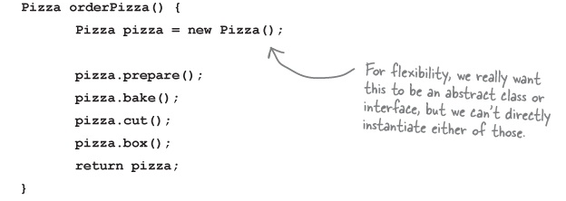
Pizza

Slide 4
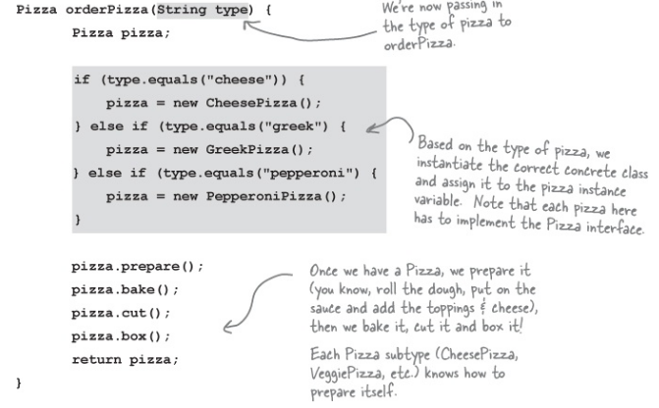

Slide 5
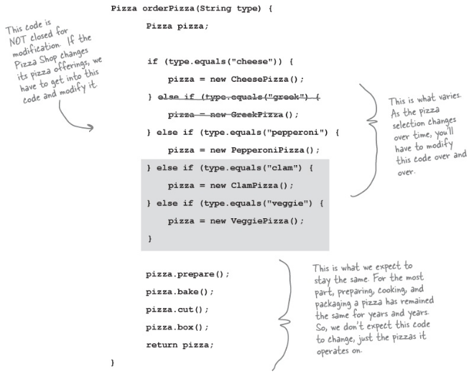
New situation violates ‘Open for extension closed for modification’

Slide 6
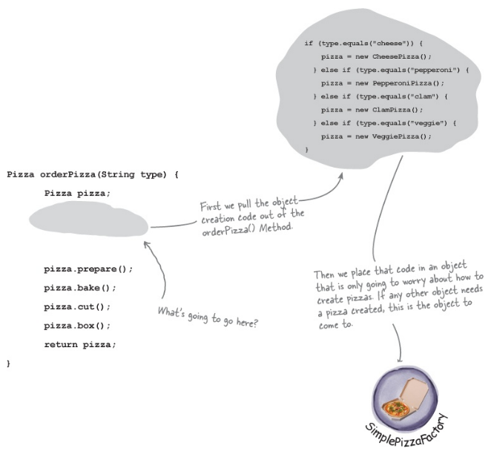

Slide 7
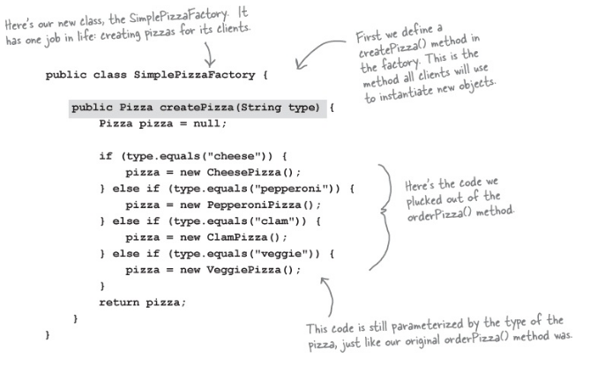

Slide 8
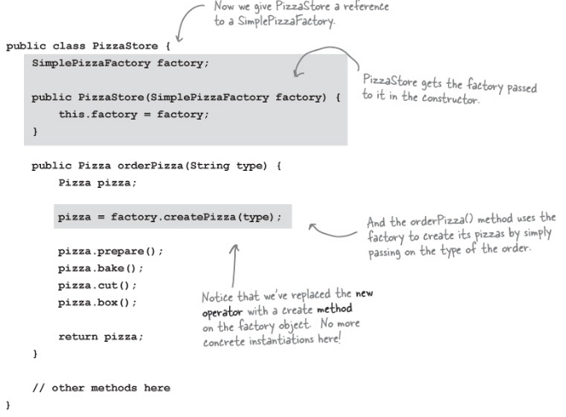

Slide 9
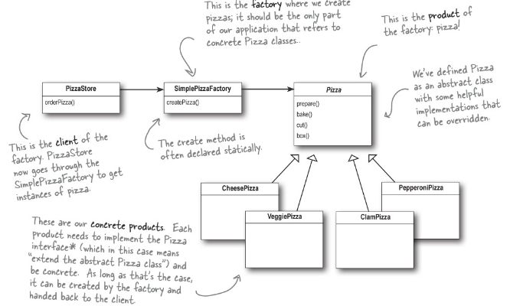

Slide 10
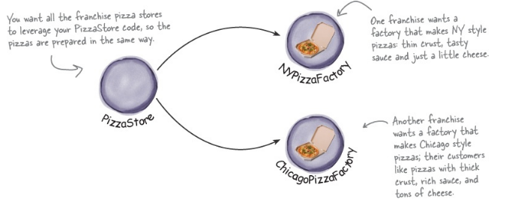
Franchising the pizza store

Slide 11
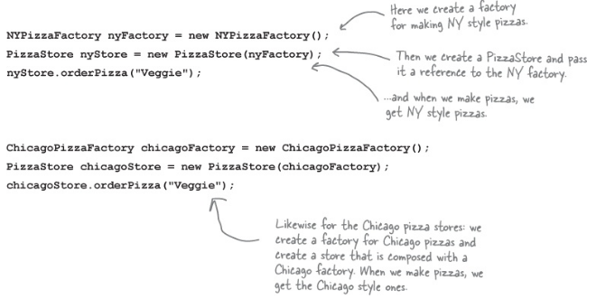

Slide 12
Factory pattern
put the createPizza() method back into PizzaStore,
but this time as an abstract method,
and then create a PizzaStore subclass for each regional style.

Slide 13
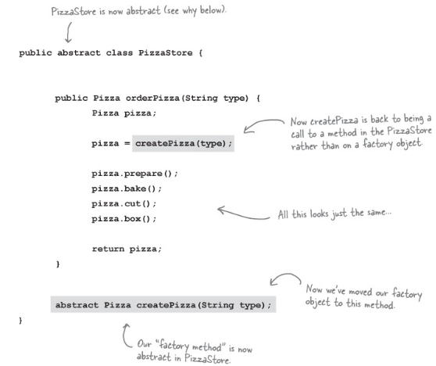

Slide 14
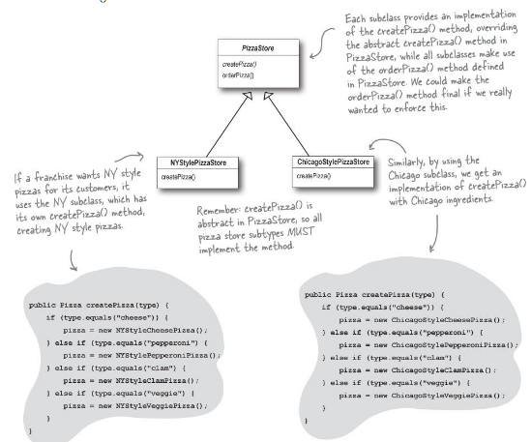

Slide 15
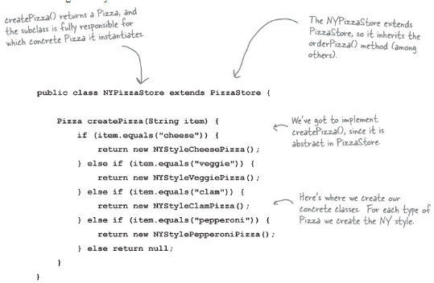

Slide 16
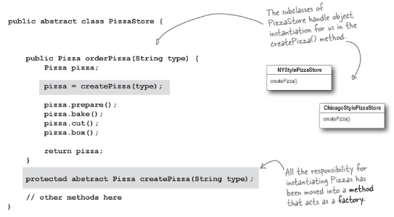

Slide 17
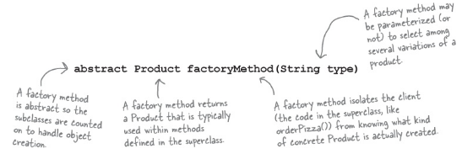
Factory method
A factory method handles object creation and encapsulates it in a subclass. This decouples the client code in the superclass from the object creation code in the subclass.

Slide 18
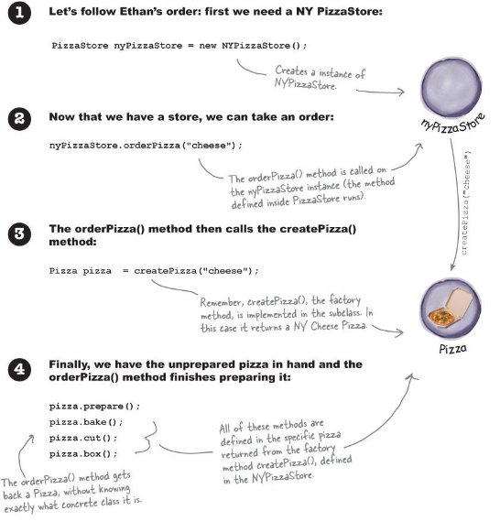

Slide 19
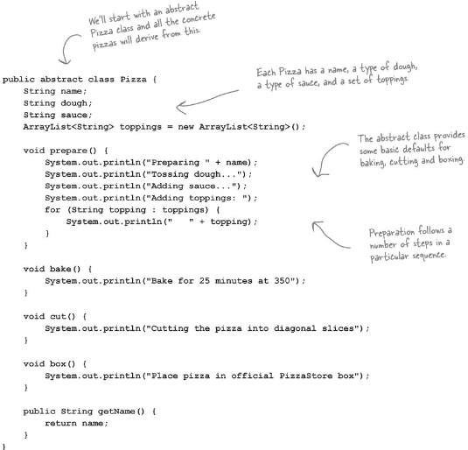

Slide 20
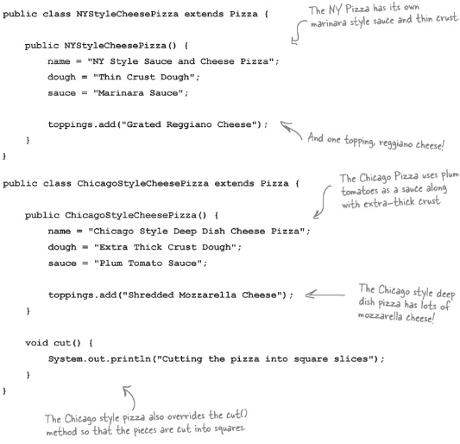

Slide 21
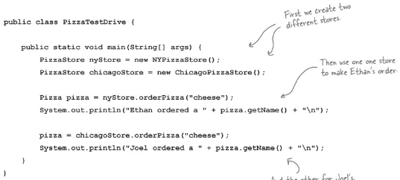
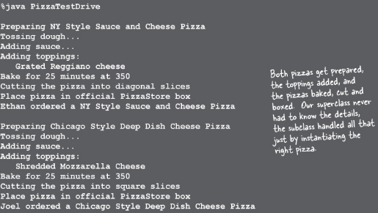

Slide 22
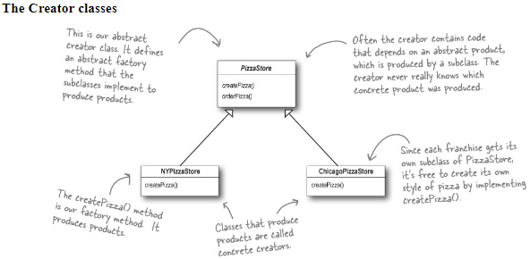
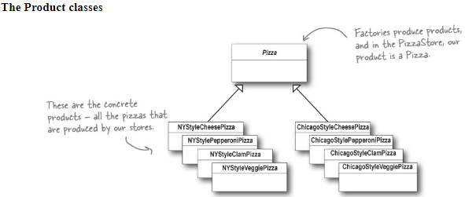

Slide 23
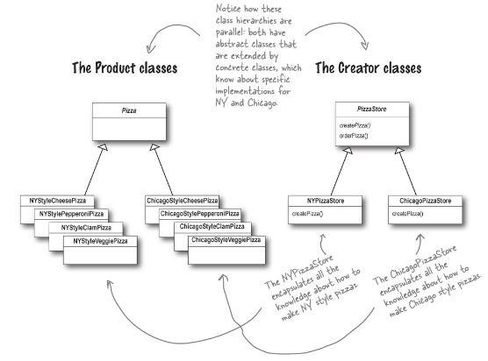

Slide 24
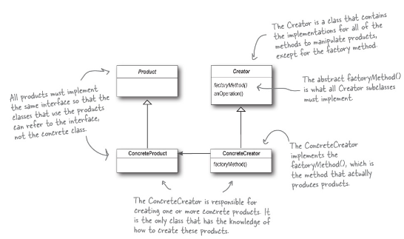
Factory

Slide 25
Simple Factory

Slide 26
Differences
the concrete stores are extending a class that has defined createPizza() as an abstract method.
It is up to each store to define the behavior of the createPizza() method.
In Simple Factory, the factory is another object that is composed with the PizzaStore.

Slide 27
Questions

Slide 28
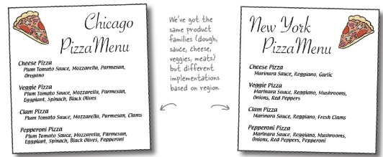

Slide 29
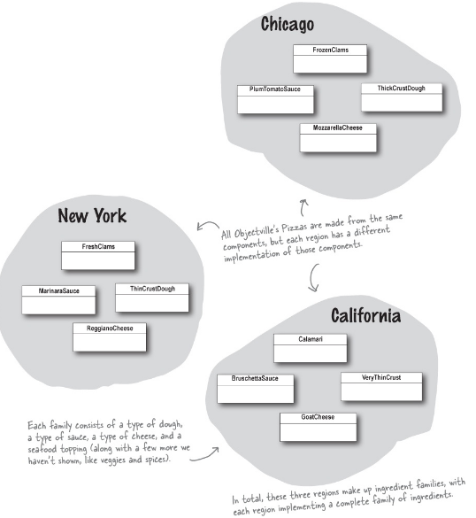
ingredient factories
the factory will be responsible for creating each ingredient in the ingredient family. The factory will need to create dough, sauce, cheese, and so on...

Slide 30
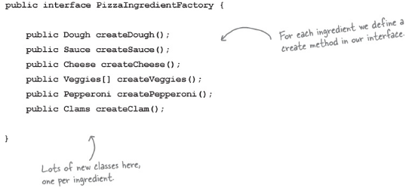

Slide 31
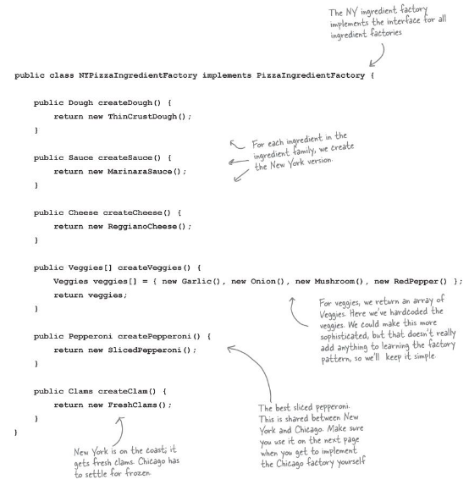

Slide 32
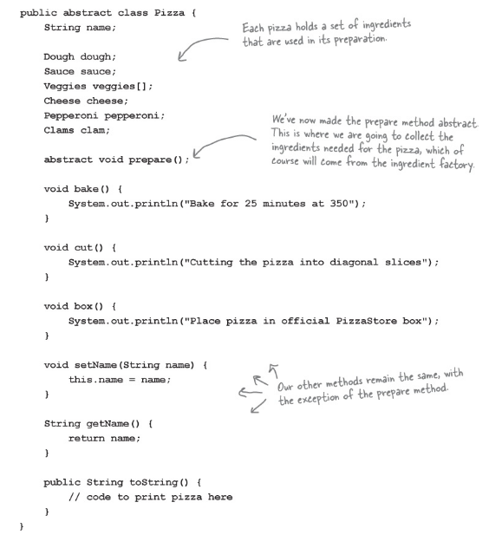

Slide 33
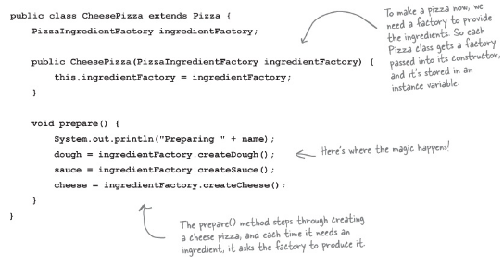
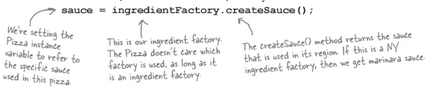

Slide 34
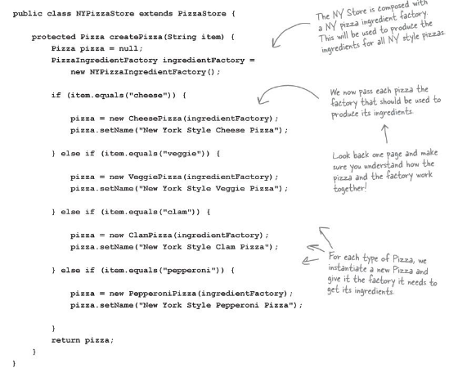

Slide 35
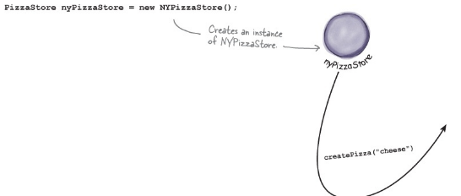
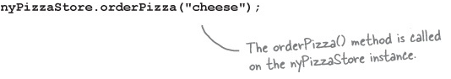

Slide 36
First we need a NY PizzaStore:
Now that we have a store, we can take an order:
The orderPizza() method first calls the createPizza() method:
Pizza pizza = createPizza("cheese");

Slide 37
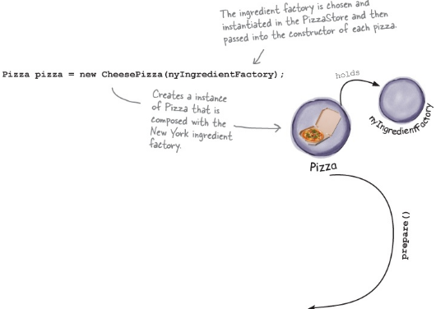
CreatePizza
When the createPizza() method is called, that’s when our ingredient factory gets involved:

Slide 38
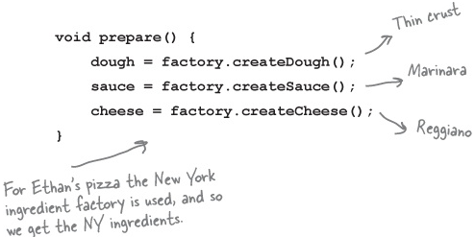
Next we need to prepare the pizza. Once the prepare() method is called, the factory is asked to prepare ingredients:
Finally, we have the prepared pizza in hand and the orderPizza() method bakes, cuts, and boxes the pizza.

Slide 39
Abstract Factory Pattern
The Abstract Factory Pattern provides an interface for creating families of related or dependent objects without specifying their concrete classes.

Slide 40
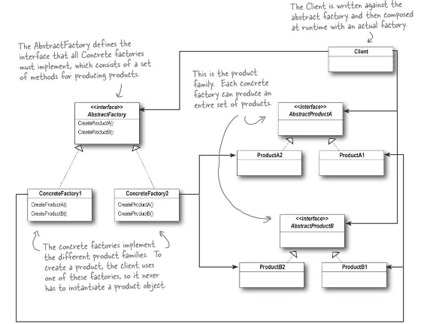

Slide 41
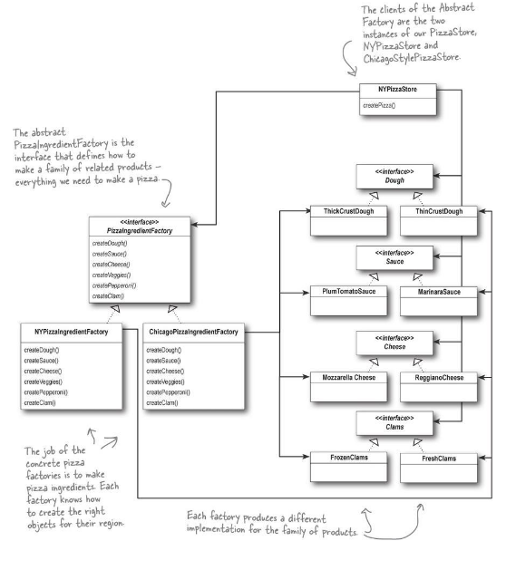

Slide 42
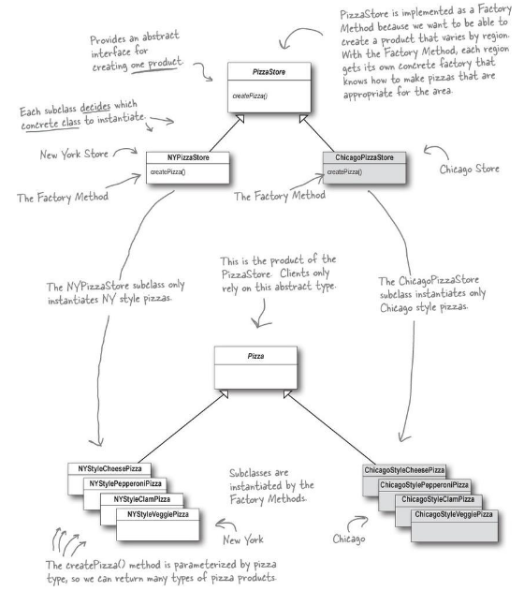

Slide 43
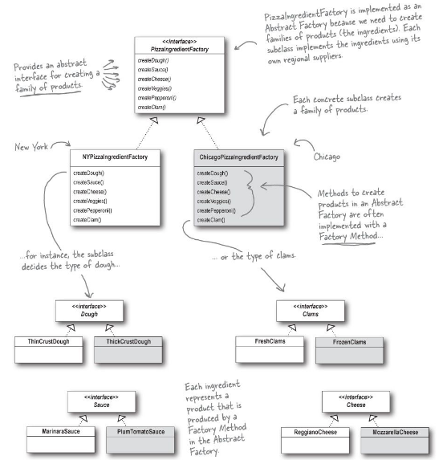

Slide 44
Summary
Abstract Factory is used whenever you have families of products you need to create and you want to make sure your clients create products that belong together.
Factory Method is used to decouple your client code from the concrete classes you need to instantiate, or if you don’t know ahead of time all the concrete classes you are going to need. To use me, just subclass me and implement my factory method!

